Slide 1
OpenCL-based Hardware-Software Co-design Methodology for Image Processing Implementation on Heterogeneous FPGA Platform
By
Sayed Omid Ayat,
Mohamed Khalil-Hani,
Rabia Bakhteri
VeCAD Research Laboratory,
Faculty Of Electrical Engineering,
Universiti Teknologi Malaysia
November 29, 2015
Ναπολέων Παπουτσάκης
ΑΕΜ : 9170

Slide 2
Abstract
Implementation of Sobel filter algorithm on Cyclone V FPGA board using OpenCL platform based on Altera SDK.
Leveraging on platform’s portability, the code is benchmarked against that of GPU and multicore CPU.
Optimization strategies for each platform.
Experimental results about computation time for each platform.

Slide 3
Why FPGAs ?
Low area and power requirement.
More suitable for portable or embedded computing than GPUs and Multicore CPUs.
Inherent fine-grained parallelism.
Image processing applications with data intensive algorithms
However…
Designing of applications in FPGAs using low level HDL.
Error prone for complex algorithms → Affect time to market the application
HDL do not consider integration of the designed HW in a framework with IOs, HW/SW interfacing

Slide 4
OpenCL ligthts as a solution
Programing model based on C/C++.
Allowing faster application development.
Code can be re-targeted to other compute devices without modification.

Slide 5
Related prior work- Convolution as main benchmark
FPGAs outperform multicore CPUs and GPUs when convolution kernel size is big.
GPUs trump others in case of smaller sizes- GPUs don’t have internal memory system.
The OpenCL efficiency have not been compared with hand crafted HDL design of the same application on FPGA.
Background
Sobel filter/operator uses two 3x3 kernels which are convolved with the original image where it creates an image emphasizing edges.
It is used because of its underlying convolution algorithm.

Slide 6
A. GPU and Multicore CPU Implementation
Multicore CPU specifications
GPU specifications
CPU Model | Cores | Threads | Frequency
Intel Core I5-3210M | 2 | 4 | 2.5GHz
Intel Core I7- 930 | 4 | 8 | 2.8GHz
GPU model | CUDA cores | Graphics Clock(MHz) | Floating Point Performance | Memory Bandwidth | Memory Interface Width
Intel HD graphic 4000 | 16 cores | 650 MHz | 332.8 GFLOPS | 25.6GB/sec | 128-bit
GeForce GT 630M | 96 cores | 800 MHz | 307.2 GFLOPS | 44.8 GB/s | 128bit

Slide 7
A.1 Sequential Execution
MultiCore CPUs are the only one that can support sequential implementation.
Key drops in efficiency when operating in Intel HD Graphics 4000.
Efficiency is restricted to the amount of spawning threads each clock cycle
Bandwidth is wasted –single uchar memory is optimized to 128 –bit data path
A.2 Pixel Vectorization
Decrease the overhead from spawning threads by four times using uchar16.
Sixteen uchar pixels in each work-item.
Additional optimization making use of float16.
Quickest way to execute computations on GPUs.

Slide 8
B. OpenCl FPGA Developement
Altera SDK for OpenCL (AOCL) enable us to do:
Intermediate compilation
Emulation
Profiling
Full deployment
AOCL translates our Sobel kernel to hardware → circuit that implements this function.
More specifically, kernel is converted into custom pipelined hw components→ pipeline parallelism.
Load modules that providing addresses for external memory and controlling the fetched information.
These are then sent into computational unit for actual execution of convolution
The results are transferred to store unit that writes them back to external memory.

Slide 9
Two different OpenCL programming models
NDrange also called data parallel programming model.
Same code as the one in GPU and multicore implementation.
Efficiency depends on how many compute units .
Work-group size can be configured manually by the designer. In GPUs and multicore CPUs, compiler used to decide it.
Single work-item kernel-similar to establishing a kernel with (1,1,1) NDrange.
There is no need to share the data among the work items- NDrange kernels demands a complex system to move the data to each work-item.
Compiler extract the parallelism automatically.

Slide 10
C. FPGA Design Using HDL
Memory access pattern analysis → current row of pixel will be reused.
Small amount of memory was included for caching rows of pixels.
Row buffer is designed by making use of reconfigurable FIFO.
Length of FIFO is adjustable → support different size of input images.

Slide 11
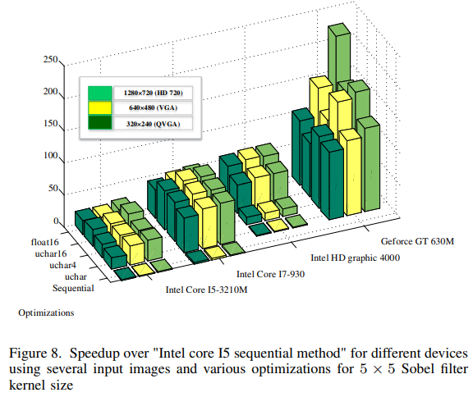
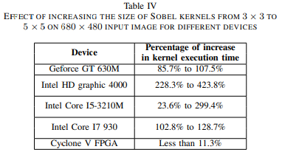
Experimental Results – GPUs vs CPUs vs FPGA
Graphs in figure 8 shown that optimizations are more noticeable when input image size gets bigger.
Speedups are compared to sequential
execution on Intel Core I5(Table I).
Increasing kernel size from 3×3 to 5×5 results
in only 11.3% increase in computation time
for FPGA(Table IV).

Slide 12
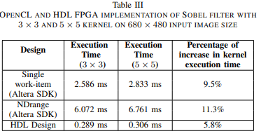
Experimental Results – FPGA Altera SDK vs HDL design
Best FPGA design is the hand crafted HDL implementation.
However , it has extremely longer development time for such a small design.
Between single work-item and NDrange methods, the former is better.

Slide 13
Conclusion
Portability of OpenCL implementation of Sobel algorithm was proved.
Altera SDK is certainly the tool be used in future work.
Improvement with the provided kernel analysis is required
Investigation of the kernel code in a cycle-accurate simulation environment before hardware generation.
Conventional trial and error testing in real world design can result in large amount of time.
Question: Could performance of Altera SDK design compete the HDL’s one, in future?

